Slide 1
Before starting your pitch deck, please do the following:
1) Complete the self-assessment form to check if your project is eligible for the 2024 awards.
2) Review “Entry Pitch Deck Instructions and Guidance” to get guidance and tips for crafting your pitch.
Note: Thithes deck will be published on the sap.com public website – be sure you have permission to submit, and do not include any confidential and/or personal data without obtaining the necessary consent. Make sure the size of your pitch deck is less than 10MB.
Delete this text box prior to submitting your pitch deck.

Slide 9
*IT benefits are required if you are using SAP Business Technology Platform products

Slide 10
For 2024 the quote does not have to be from a specific person but could also be an anecdotal comment
Delete this text box prior to submitting

Slide 11
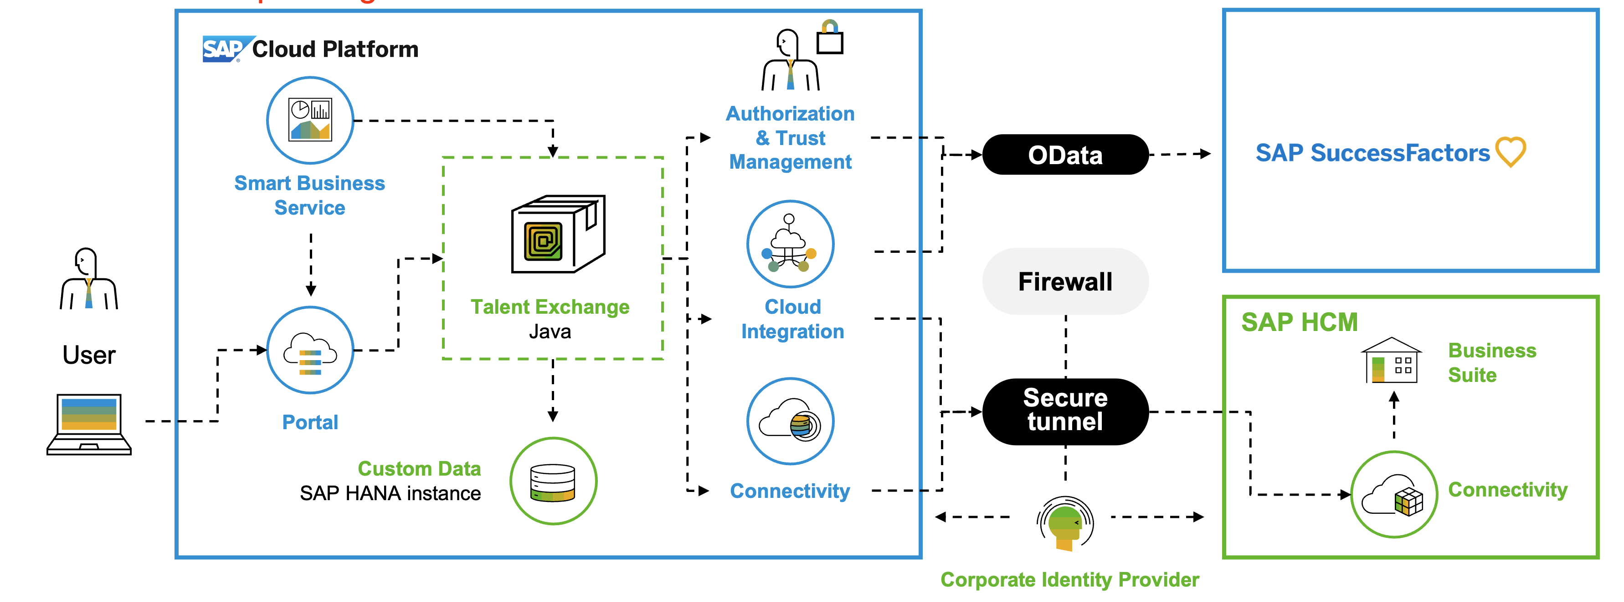
This slide is optional. The diagram below is an example of an architecture diagram. Please delete and provide your own. We recommend using “SAP Business Technology Platform Diagram & Icon Guidelines” to create your diagram.
Delete this text box prior to submitting
Business Technology Platform
FPO

Slide 12
 | SAP PRODUCT | DEPLOYMENT STATUS LIVE/POC | SAP AI SCENARIO (if applicable) | CONTRIBUTION TO PROJECT
1 | Example: SAP IBP | Example: Live | Example: Demand Sensing
2
3
4
5

Slide 13
 | TECHNOLOGY | SAP BTP SOLUTION | CONTRIBUTION TO PROJECT
1 | Application Development and Automation
2 | Extended Planning and Analysis
3 | Data and Analytics
4 | Integration
5 | Artificial Intelligence

Slide 14
 | SAP SERVICE or APPLICATION PACKAGE | CONTRIBUTION TO THE PROJECT
1 | Enter the SAP Service or Application Package | Provide impact; contribution; purpose of service/package within this project and value achieved
2
3
4
5

